Slide 1
Jagan Nath Gupta Institute of Engineering and Technology
Session 2019-20
Industrial Training
By Jaideep Singh (B.Tech 3rd Sem. CS)
Roll No. 18EJGCS011

Slide 2
Bank System
Bank Management System Project

Slide 3
Content
01
Introduction
Bank Management System
02
About Project
Project developed using C language.
03
Functions
Creation(), Deposit(), Withdraw(), Balance()
04
Activities
Create Account, Deposit Money, Withdraw Money, Check Balance, Close Account, Exit

Slide 4
Introduction
Bank Management System is based on a concept of recording customer’s account details. Here the user can perform all the tasks like creating an account, deposit amount, withdraw amount, check balance, close an account and modify an account. There’s no login system for this project. All the main features for banking system are set in this project.

Slide 5
About Project
Talking about the features of the Bank Management System, a user can create an account by providing the name of the account holder, account number, select amount type whether its Saving account or Current account and providing an initial amount. Then the user can also deposit and withdraw money just by providing his/her account, then the system displays his/her profile and entering an amount. For certain purpose, he/she can also check for the balance inquiry which displays the account holder’s name with account number type and amount. He/she can also check for all the account holder’s list. Another feature is that the user can also close their account by providing their account number and he/she can modify their account detail and type if they want to.
BANK

Slide 6
Functions
Creation()
Create a new account in the bank.
Balance()
Deposit()
Display the balance in the account.
BANK
Deposit money into the bank account.
Withdraw()
Withdraw money from the bank account.

Slide 7
Activities
Create Account
Check Balance
A user can create an account by providing the name of account holder, account number and select account type.
The user can also check for the balance inquiry which displays the account holder’s name with account number type and amount.
Deposit Money
The user can deposit money just by providing his/her account, then the system displays his/her profile and entering an amount.
Modify
The user can also close their account by providing their account number and he/she can modify their account detail and type if they want to.
Withdraw Money
The user can also withdraw money just by providing his/her account, then the system displays his/her profile and entering an amount.

Slide 8
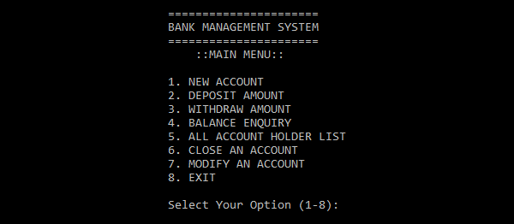
A look to our program…
START

Slide 9
THANK YOU

